Slide 1

Leave Application Management System
NGS Exchange student

Slide 2

CONTENTS
01.
Member Introduction
02.
System Introduction
03.
Database and Tables
04.
Interface prototype

Slide 3
PART 01
Member Introduction

Slide 4

MEMBER:
DING LU (X18CS3001) Staff function
HAO YUNTING (X18CS3002) Manager function
ZHANG JIAWANG (X18CS3003) Login，regist，combine
CHEN RUOFAN (X18CS3004) Admin function

Slide 5
PART 02
System Introduction

Slide 6
Website Purpose
Leave Application Management System can provide users with more convenient and more complete leave services.
Users can fill out the leave slips online to see if they are approved, and do not need to go to the office to apply.
At the same time, the manager can also approve the fake bars online to check the status of all the fake bars.
There are three modules of the System:
(1). Staffs (User)
(2). Managers (Manager)
(3). Administrators (Admin)

Slide 7
Tools & Technology
HTML&CSS
Write the basic structure of the code &
Modify the style of the page
PHP
PHP program for server, used to write background code
MySQL
Connect to the database, insert, delete, query, etc.
JavaScript
Make static web pages dynamic web pages
Github
An open source platform for code integration

Slide 8



Modules Overview
Admin
Manager
User
* Administrators can view the personal information of all employees, sort by each type of information, and view administrator information.
* Administrators also can view the information and application status of all the fake bars.
* Administrators can modify employees information.
* Managers can view the application and approve or reject the employee's leave slip.
* Manager can modify personal information.
* Manager can view the names and departments of all staff members who are on leave, sort by name or department, and view all leave information for each employee.
* Users can modify personal information.
* Users can fill in the leave slip and apply for leave.
* Users can view the application results.

Slide 9
Functionality
--Admin
4. Delete, add new user information
Login account
5. View all fake application status
2. View all users' personal information
6. Sort fake application in ascending and descending order
3. Modify employee
information

Slide 10
Functionality
--Managers
4. Approving or rejecting employee leave
Login account
5. View the names and departments of all
employee
2. Modify Personal Information
6. View all leave information for each employee
3. View all pending strips.

Slide 11
Functionality
--Staff
4. Fill in the leave and submit
Register an account
5. View application results
2. Login account
3. Edit personal information

Slide 12
PART 03
Database and Tables

Slide 13

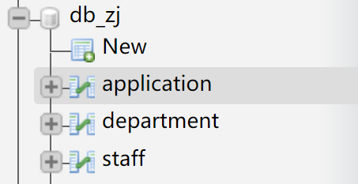
three tables used in the database for this project
Database Name: db_zj
Table:
Name: Application
For: To store all leave applications.
Relate Table: staff,department
2. Name: Staff
For: To store staffs,admins and managers’ information.
Relate Table: department,application
3. Name: Department
For: To store information about staffs’ department.
Relate Table: staff,application

Slide 14
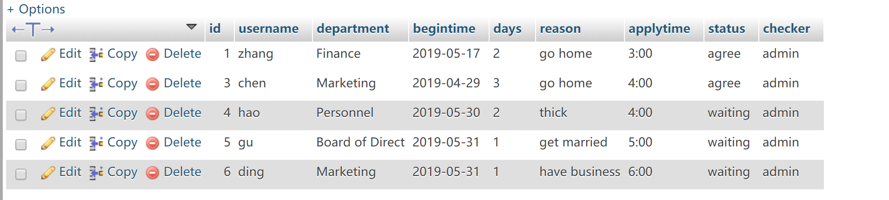
Application Table

Slide 15
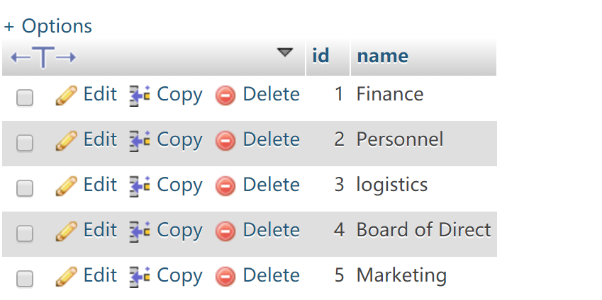
Department Table

Slide 16
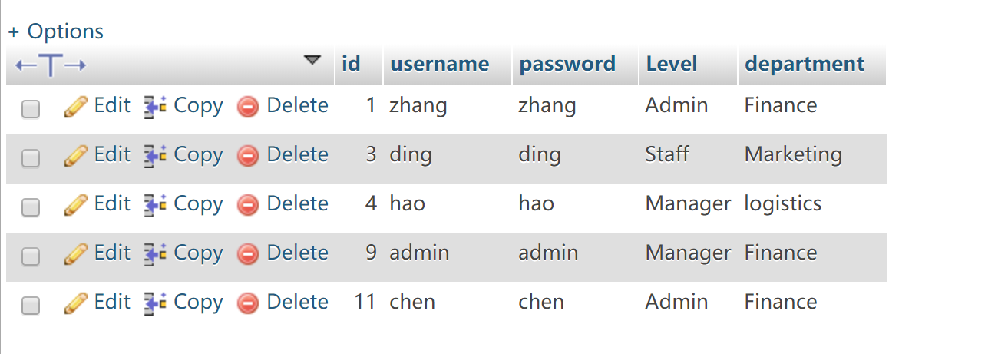
Staff Table

Slide 17
PART 04
Interface prototype

Slide 18
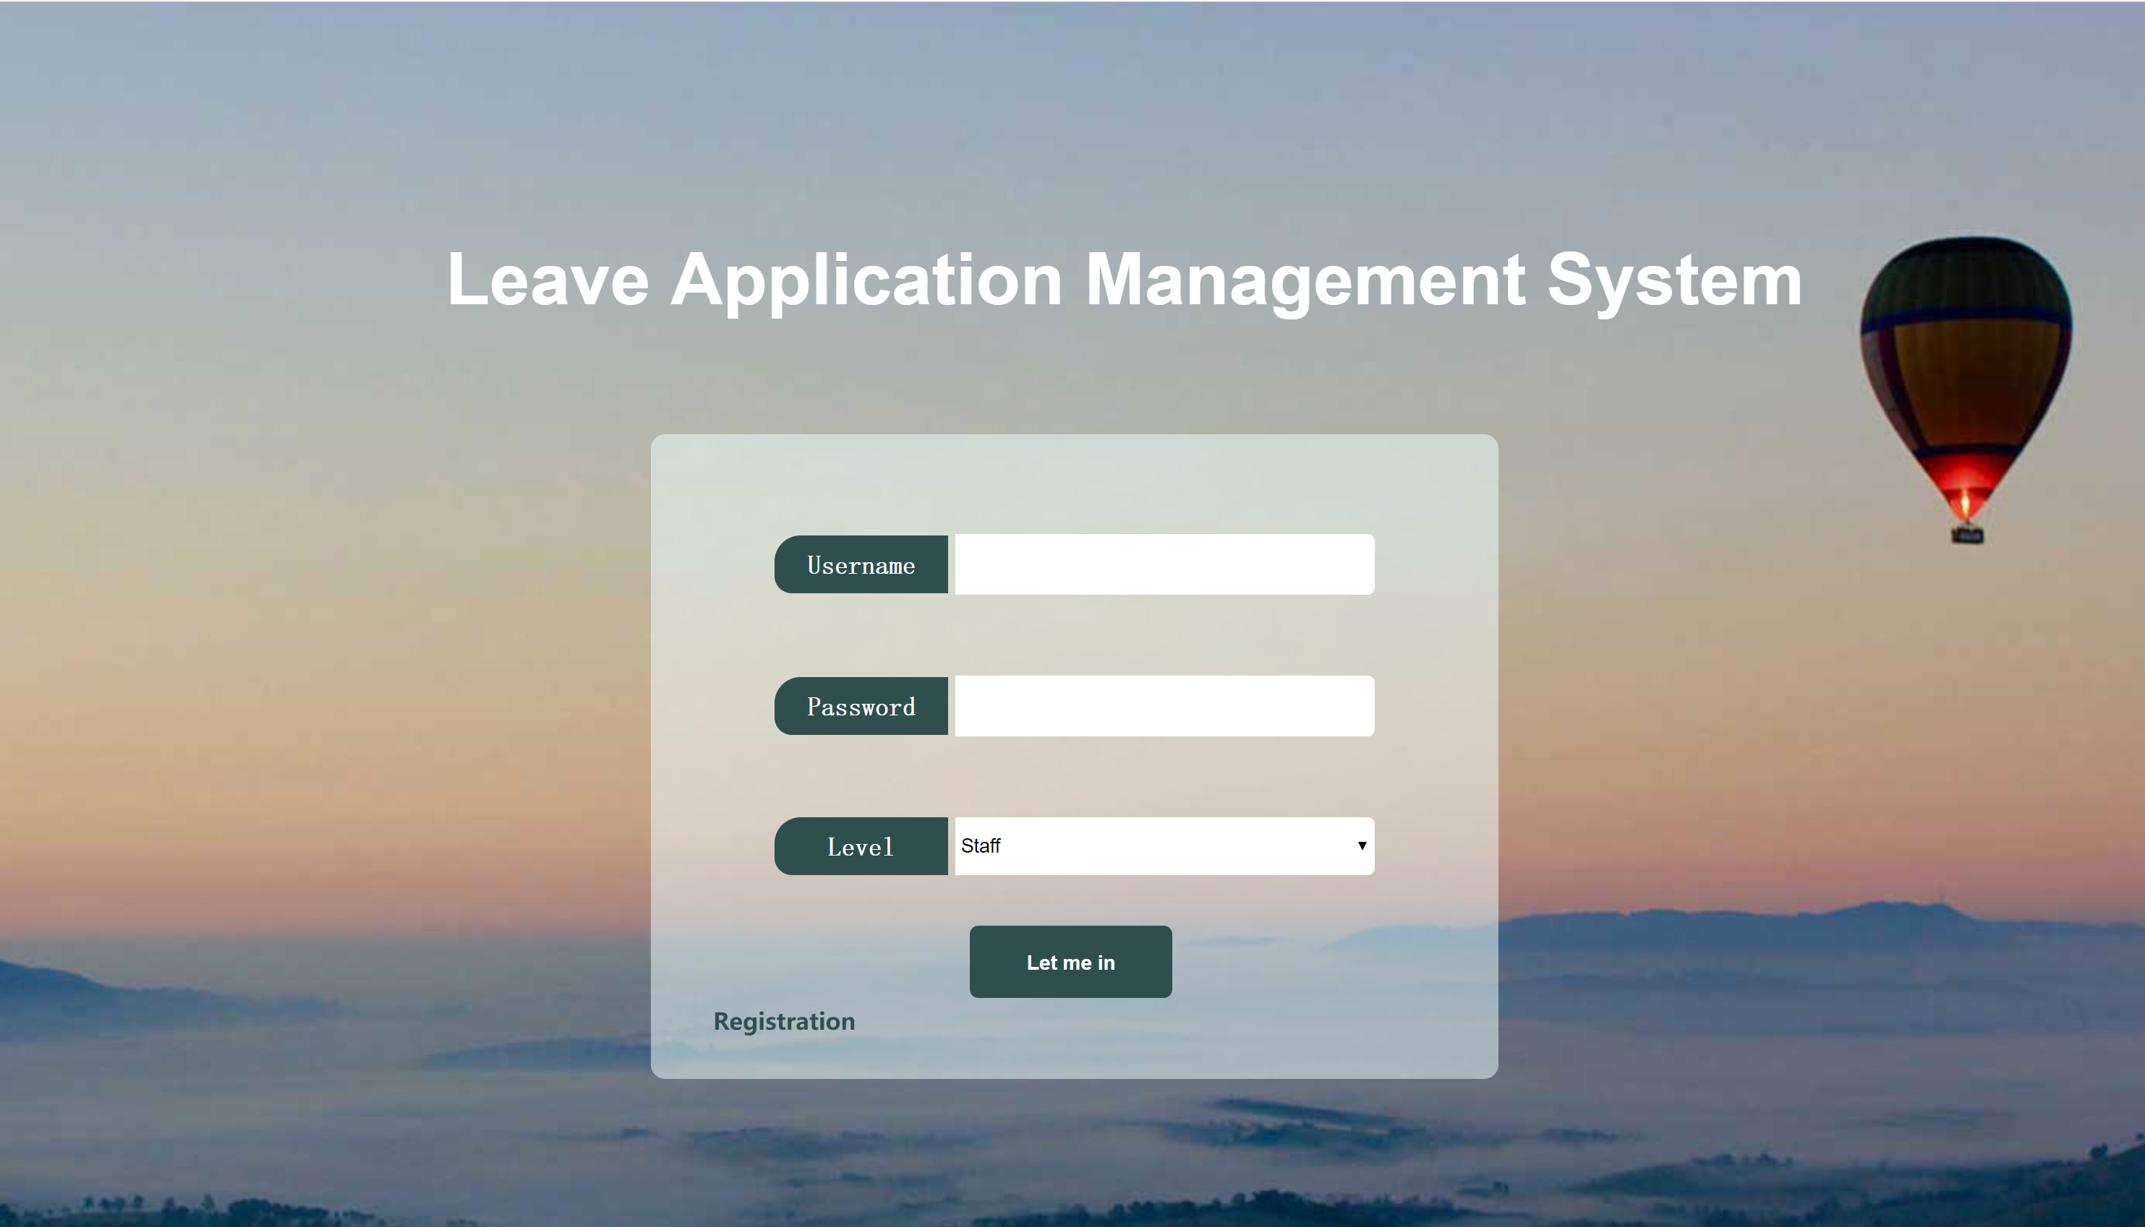
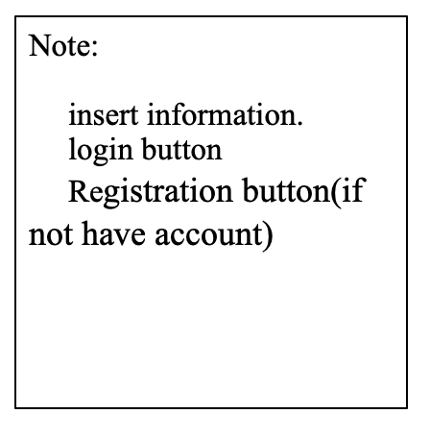
Login Page

Slide 19
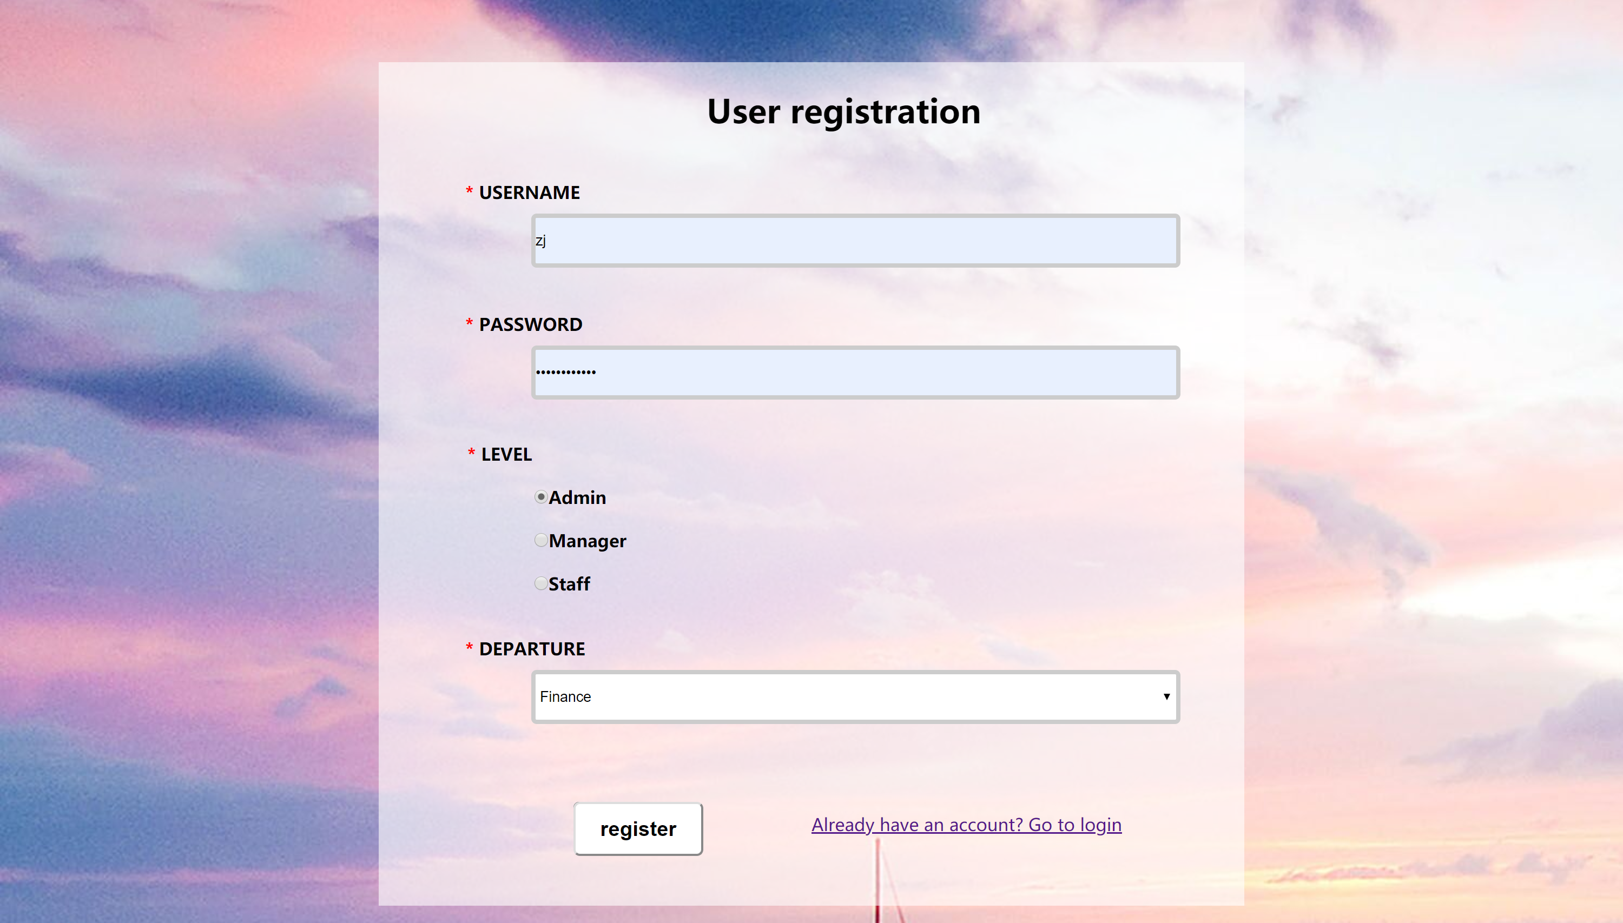
Registration Page:
Note:
Insert information
Button – register a new account

Slide 20
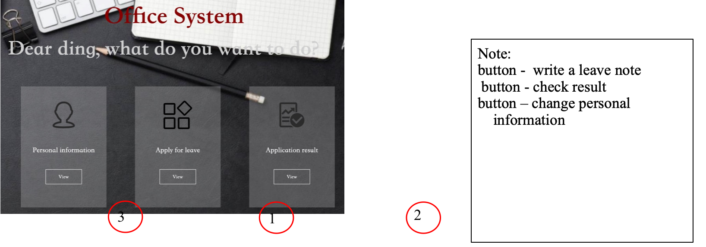
Staff Main Page:

Slide 21
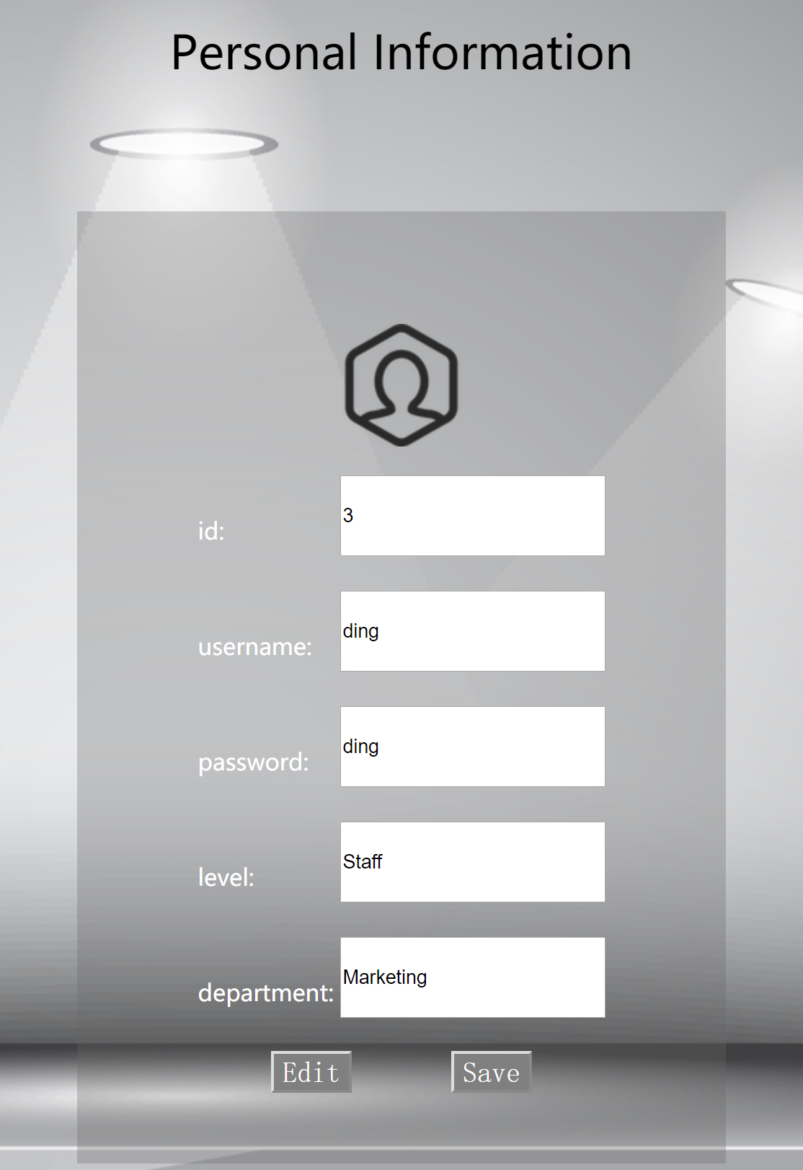
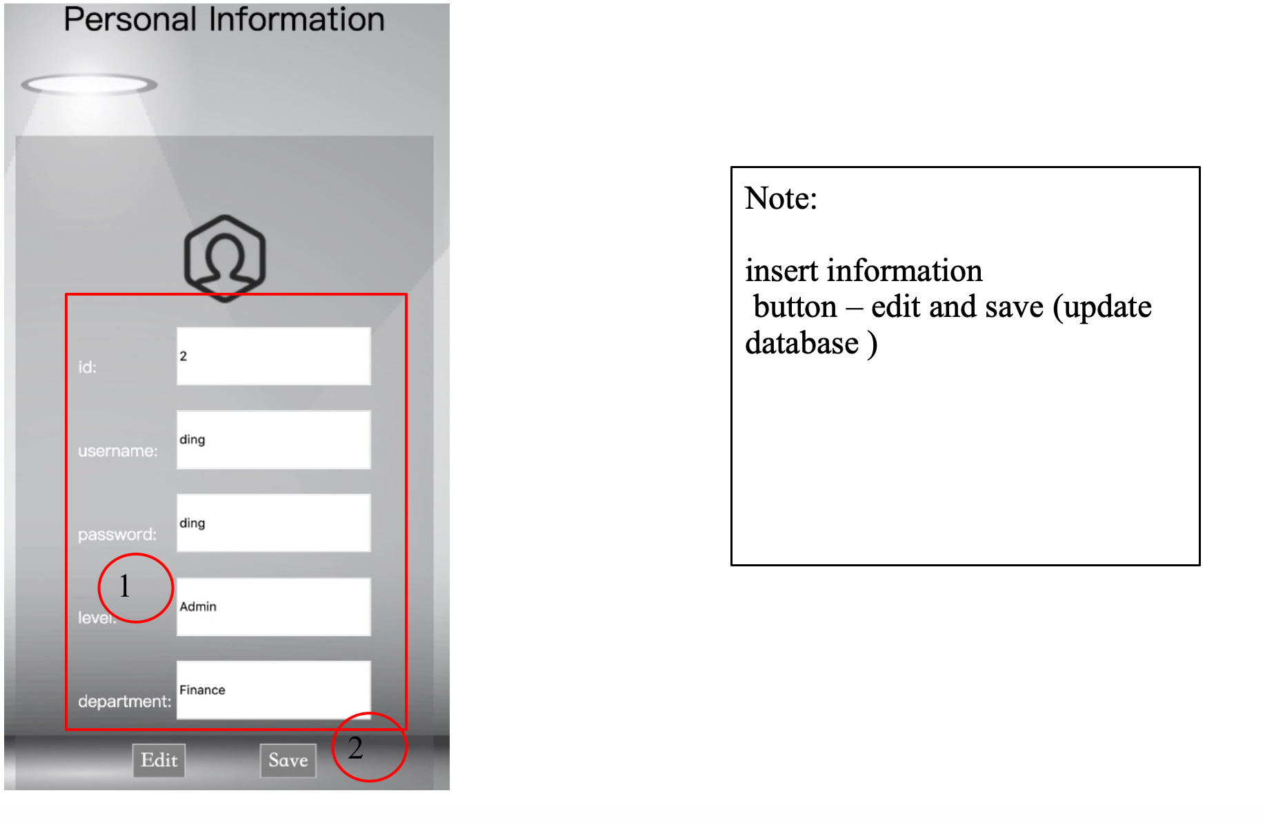
Modify Personal Information

Slide 22
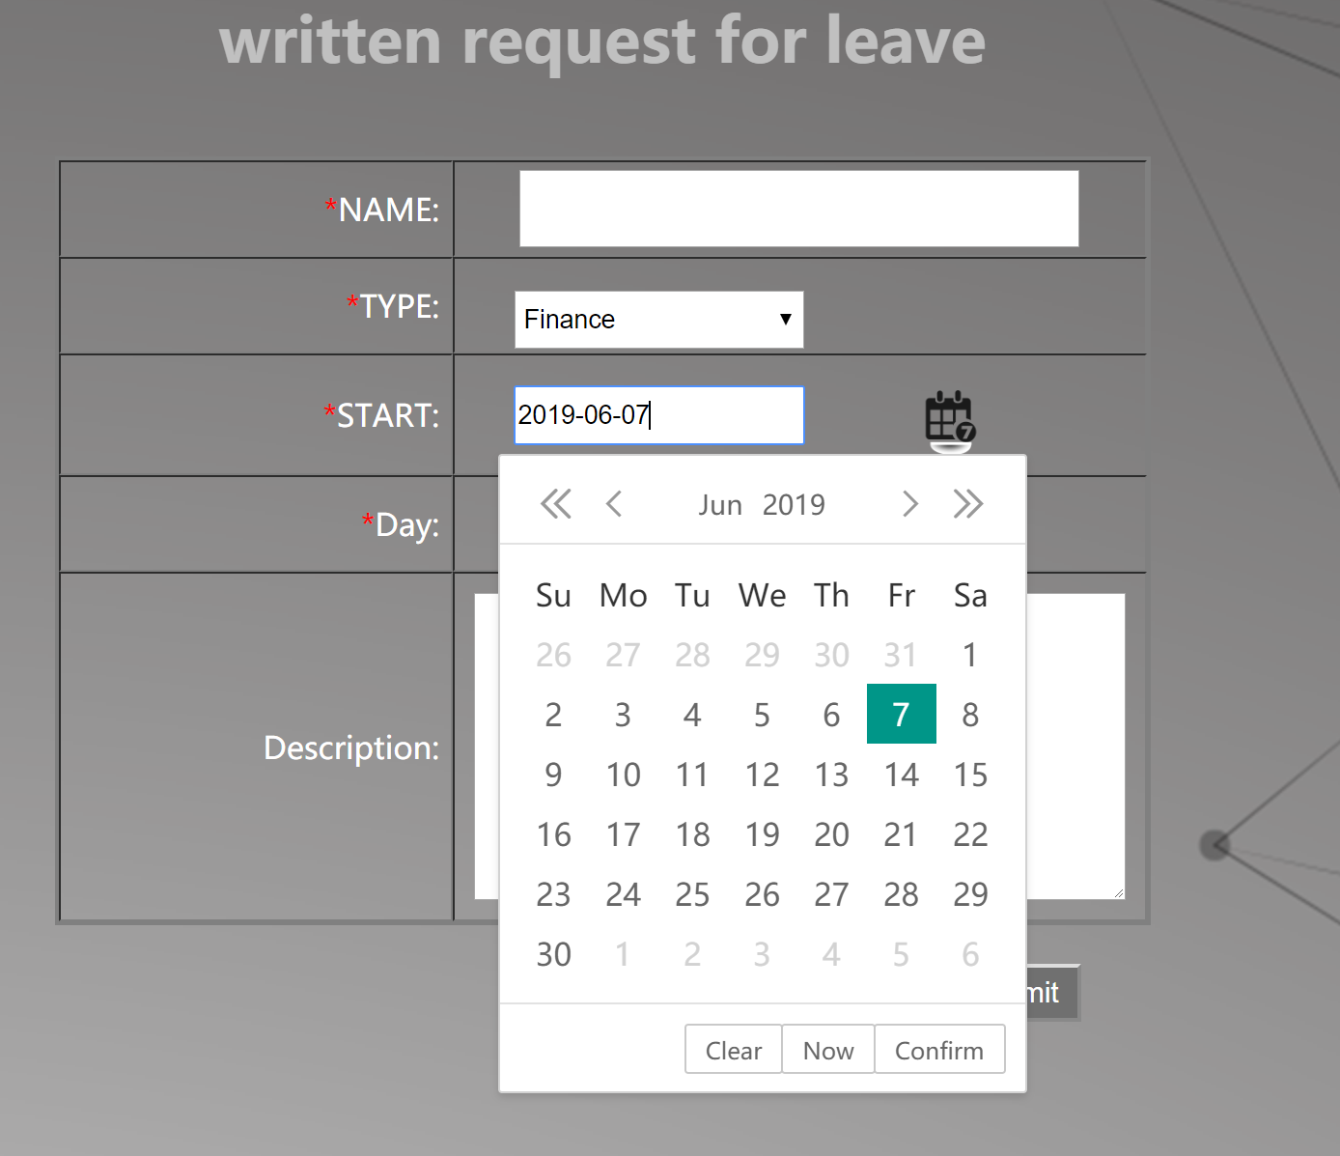
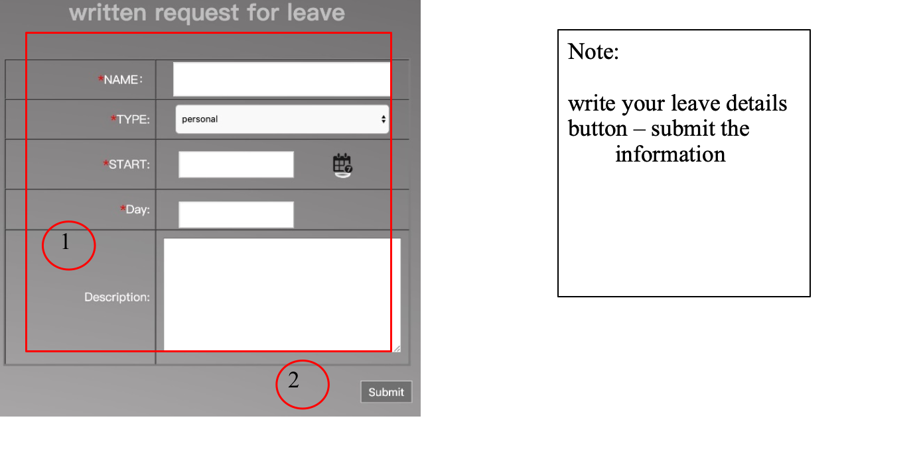
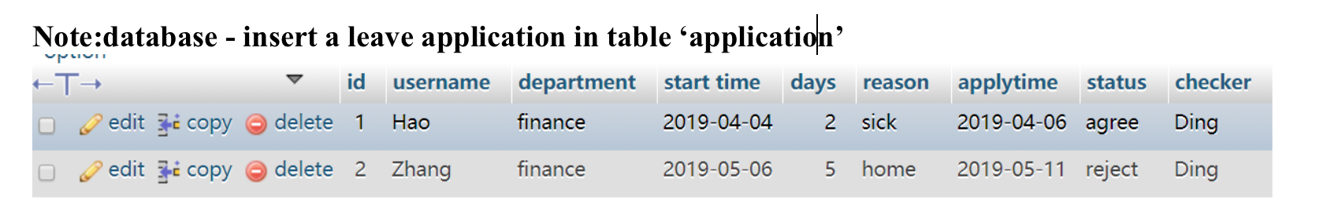
Staff write a leave application:

Slide 23
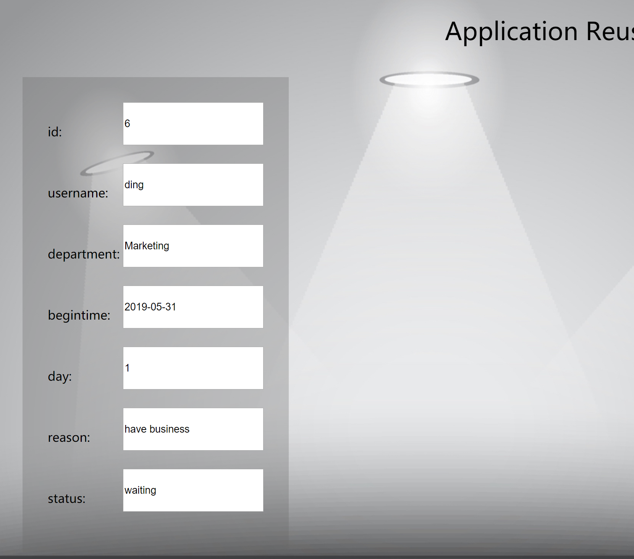
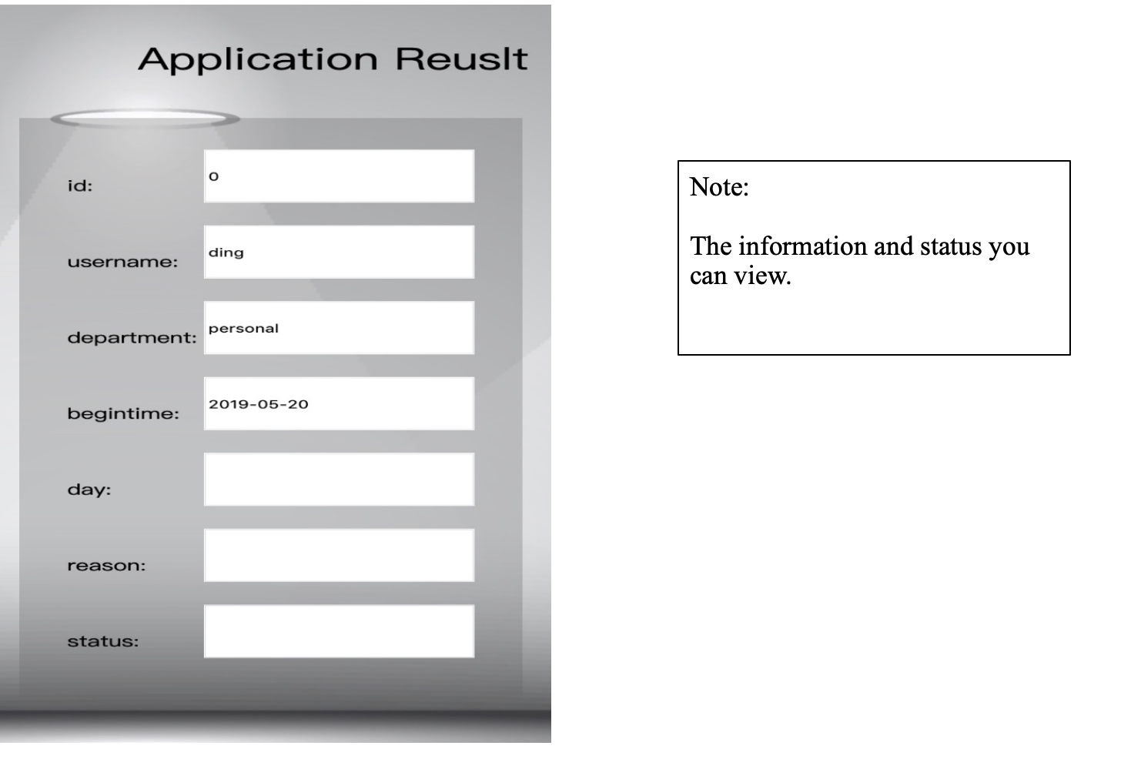
View leave status:

Slide 24
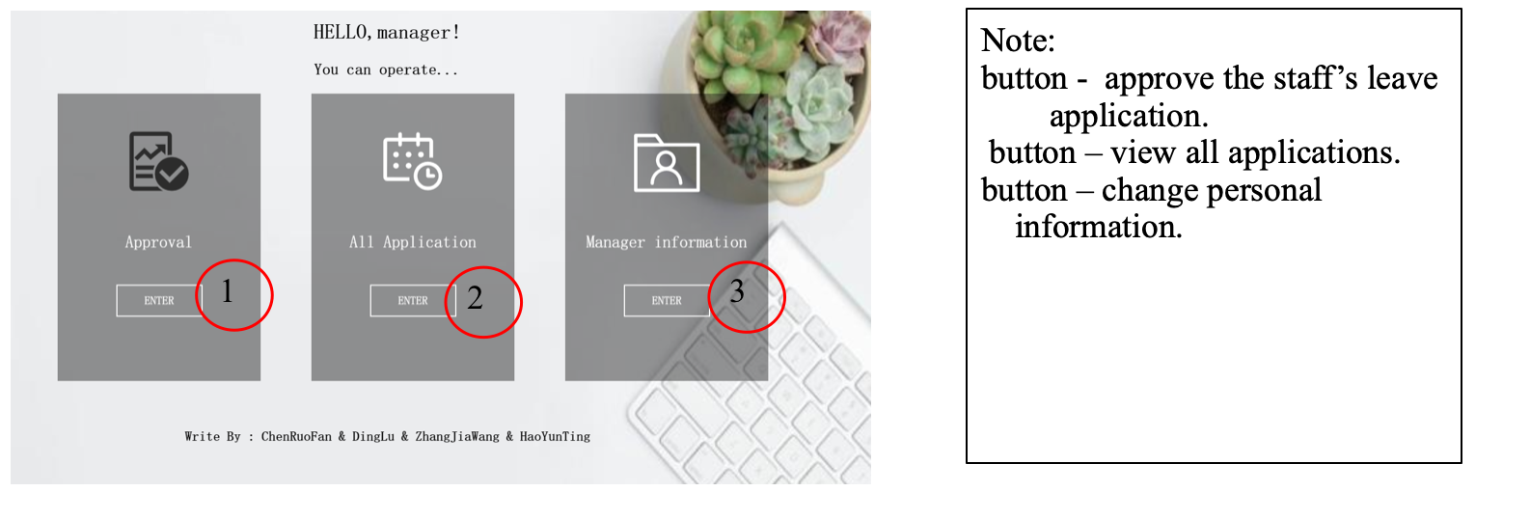
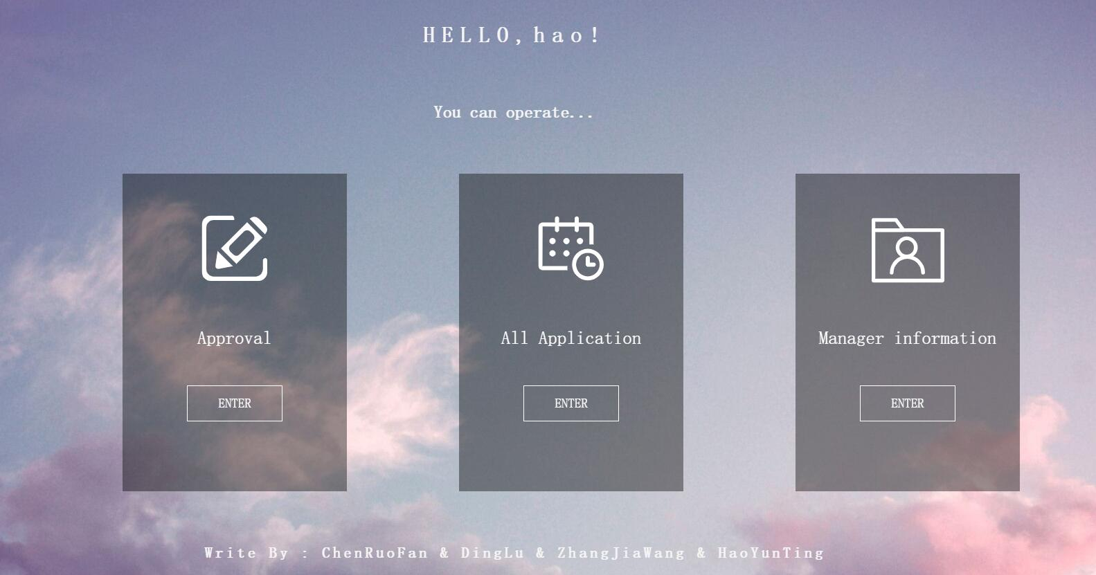
Manager Main Page:

Slide 25
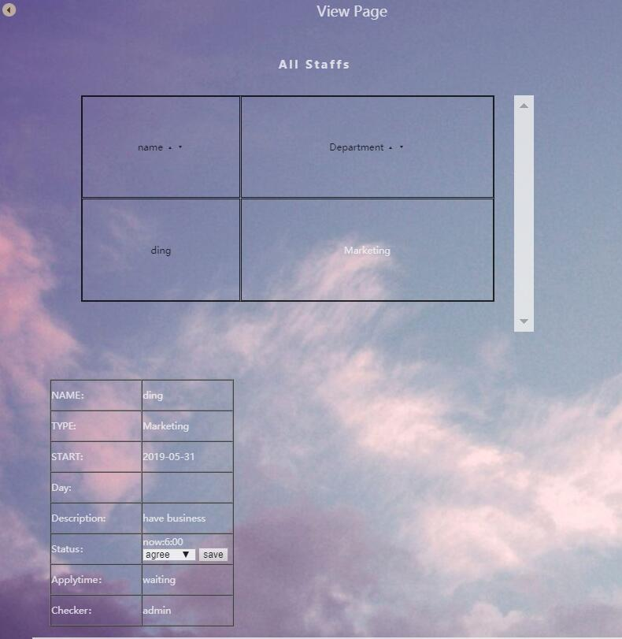
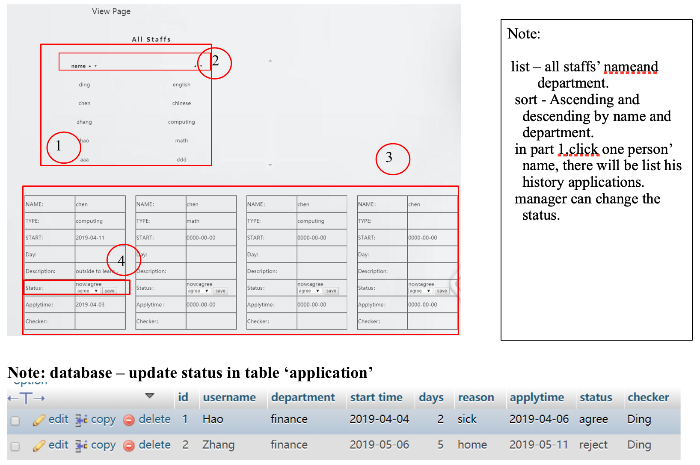
See all applications:

Slide 26
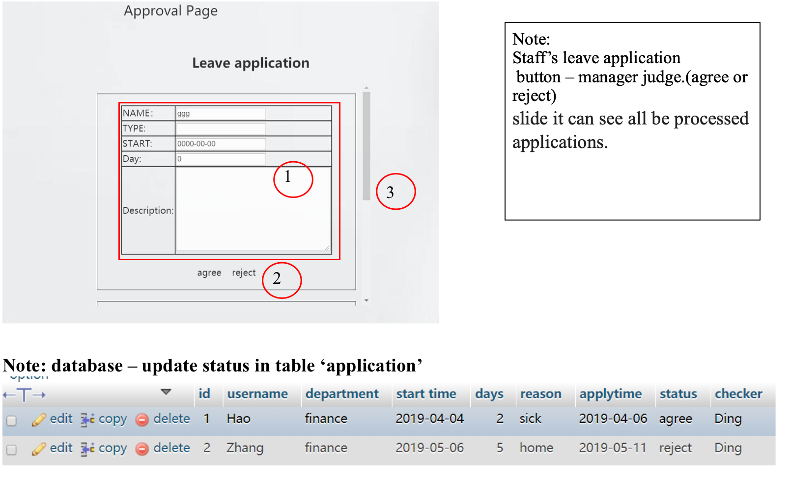
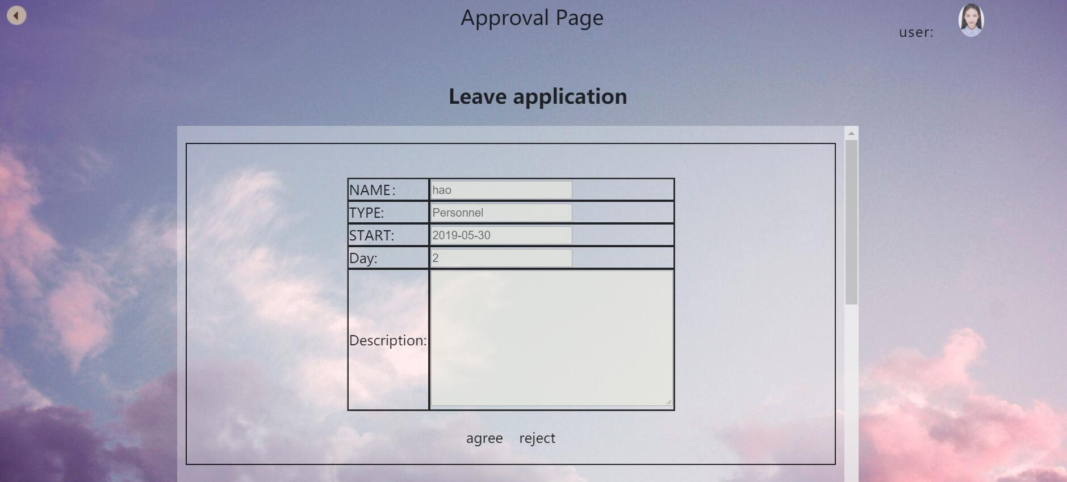
Approval application:

Slide 27
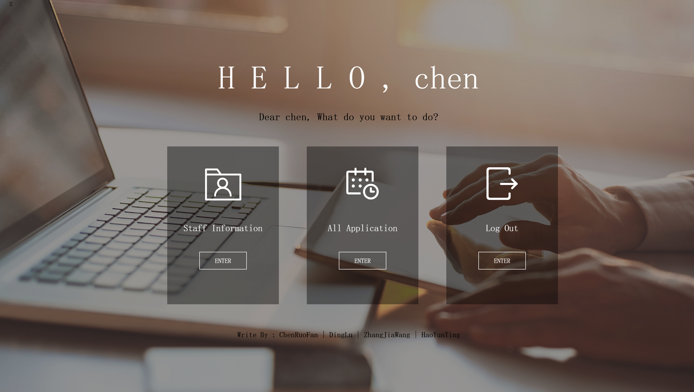
Admin Main Page:
Get username from login page
Get Staff Information
Get All Application
Log Out

Slide 28
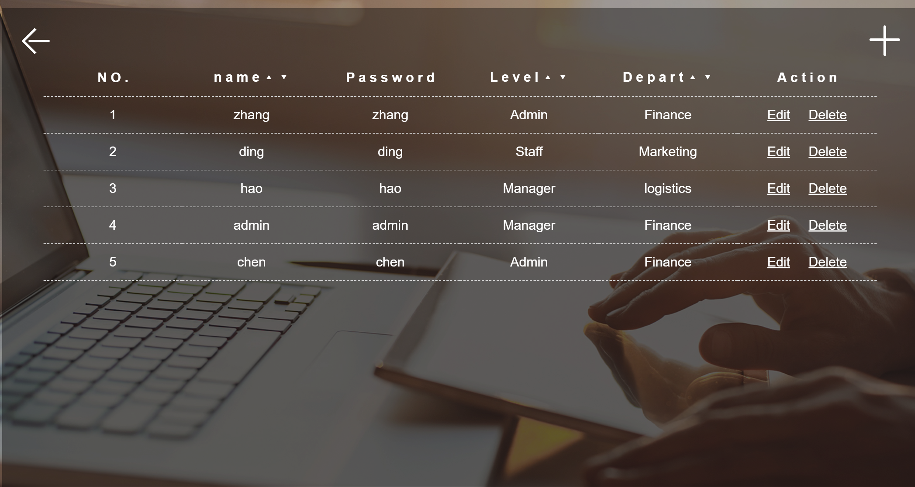
Staff List Page:
Edit Staff Information

Slide 29
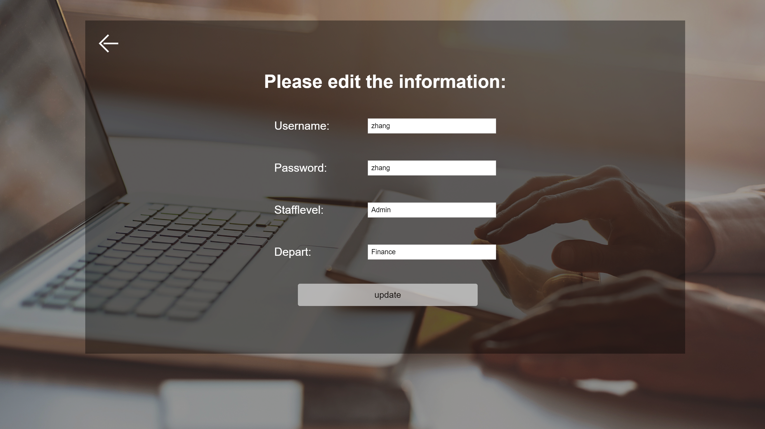
Edit Staff List Page:
Get This Staff’s Information
After Edit update

Slide 30
Delete Staff Page:
Delete Staff Information

Slide 31
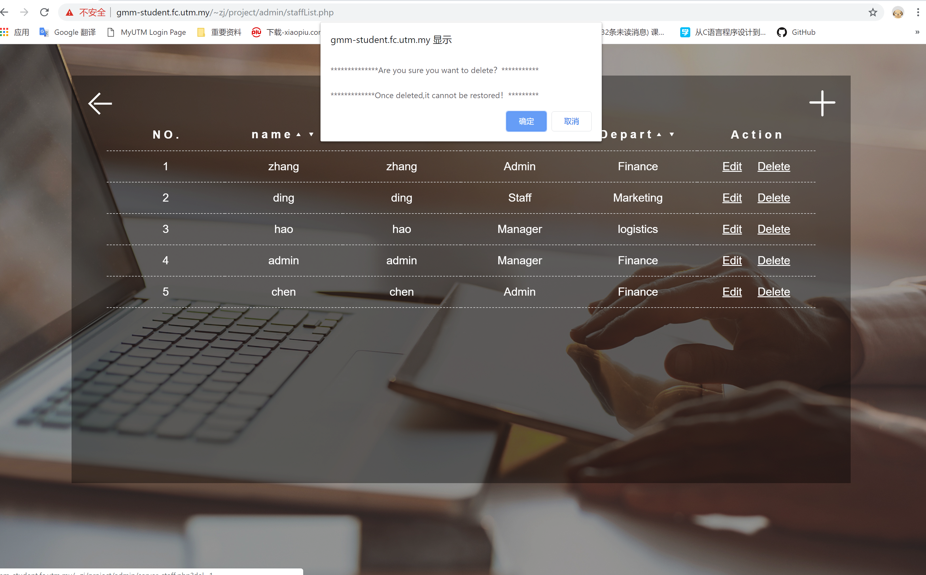
Delete Staff Page:

Slide 32
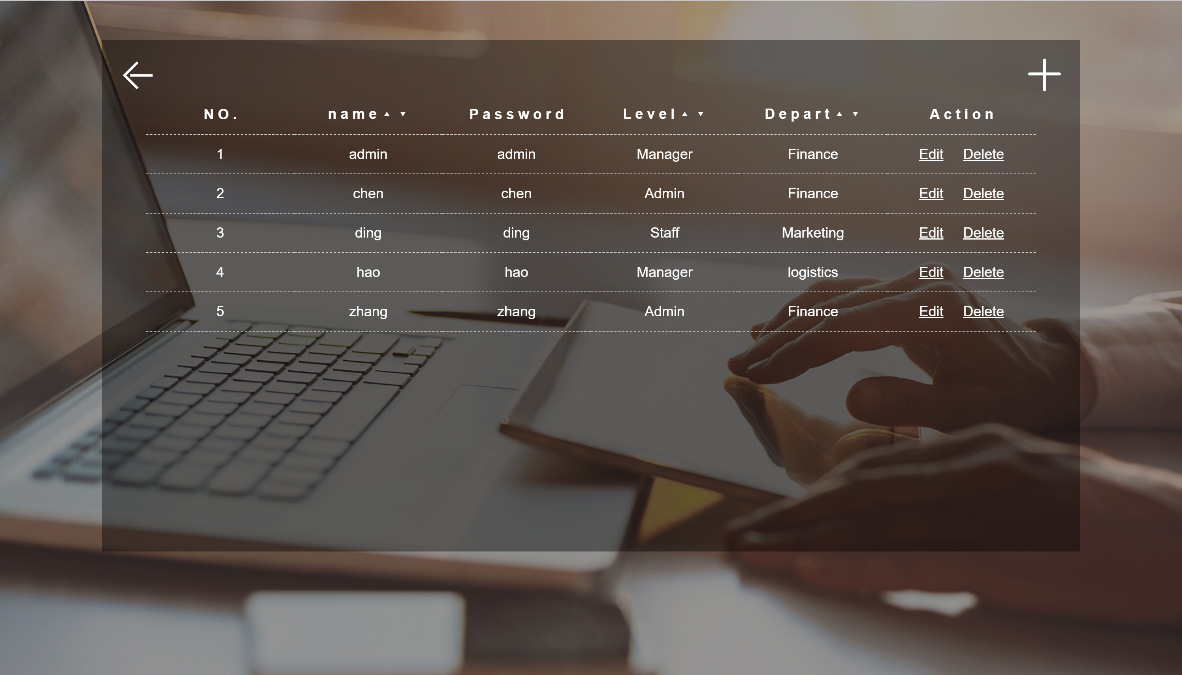
Order Staff Page:
Order by ASCII

Slide 33
Add Staff Page:
Add Staff

Slide 34

Add Staff Page:
Add Staff

Slide 35
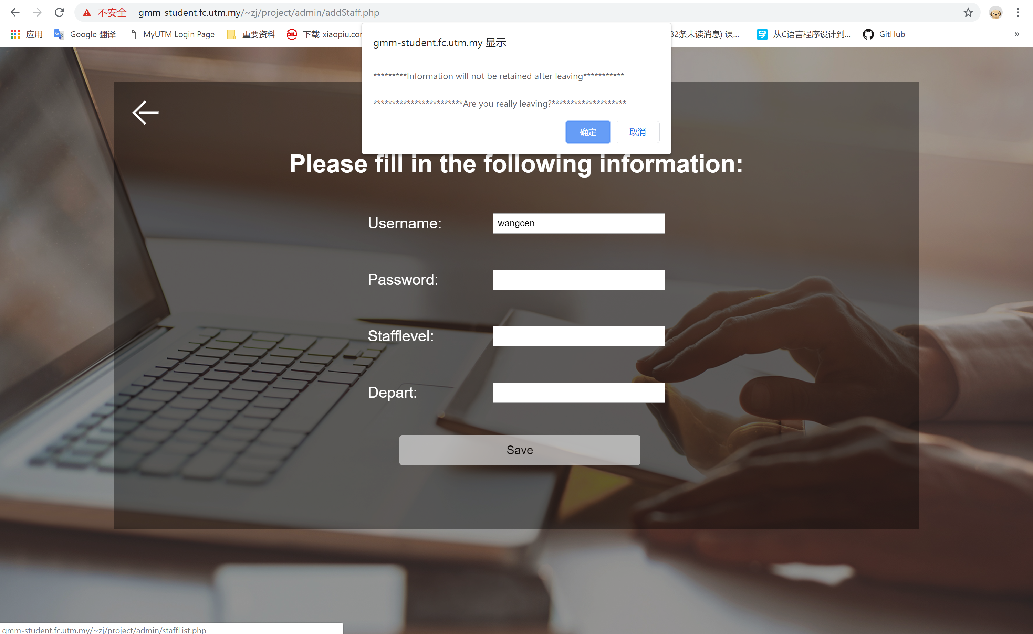
Leave Add Staff Page:
If you leave without ‘save’

Slide 36
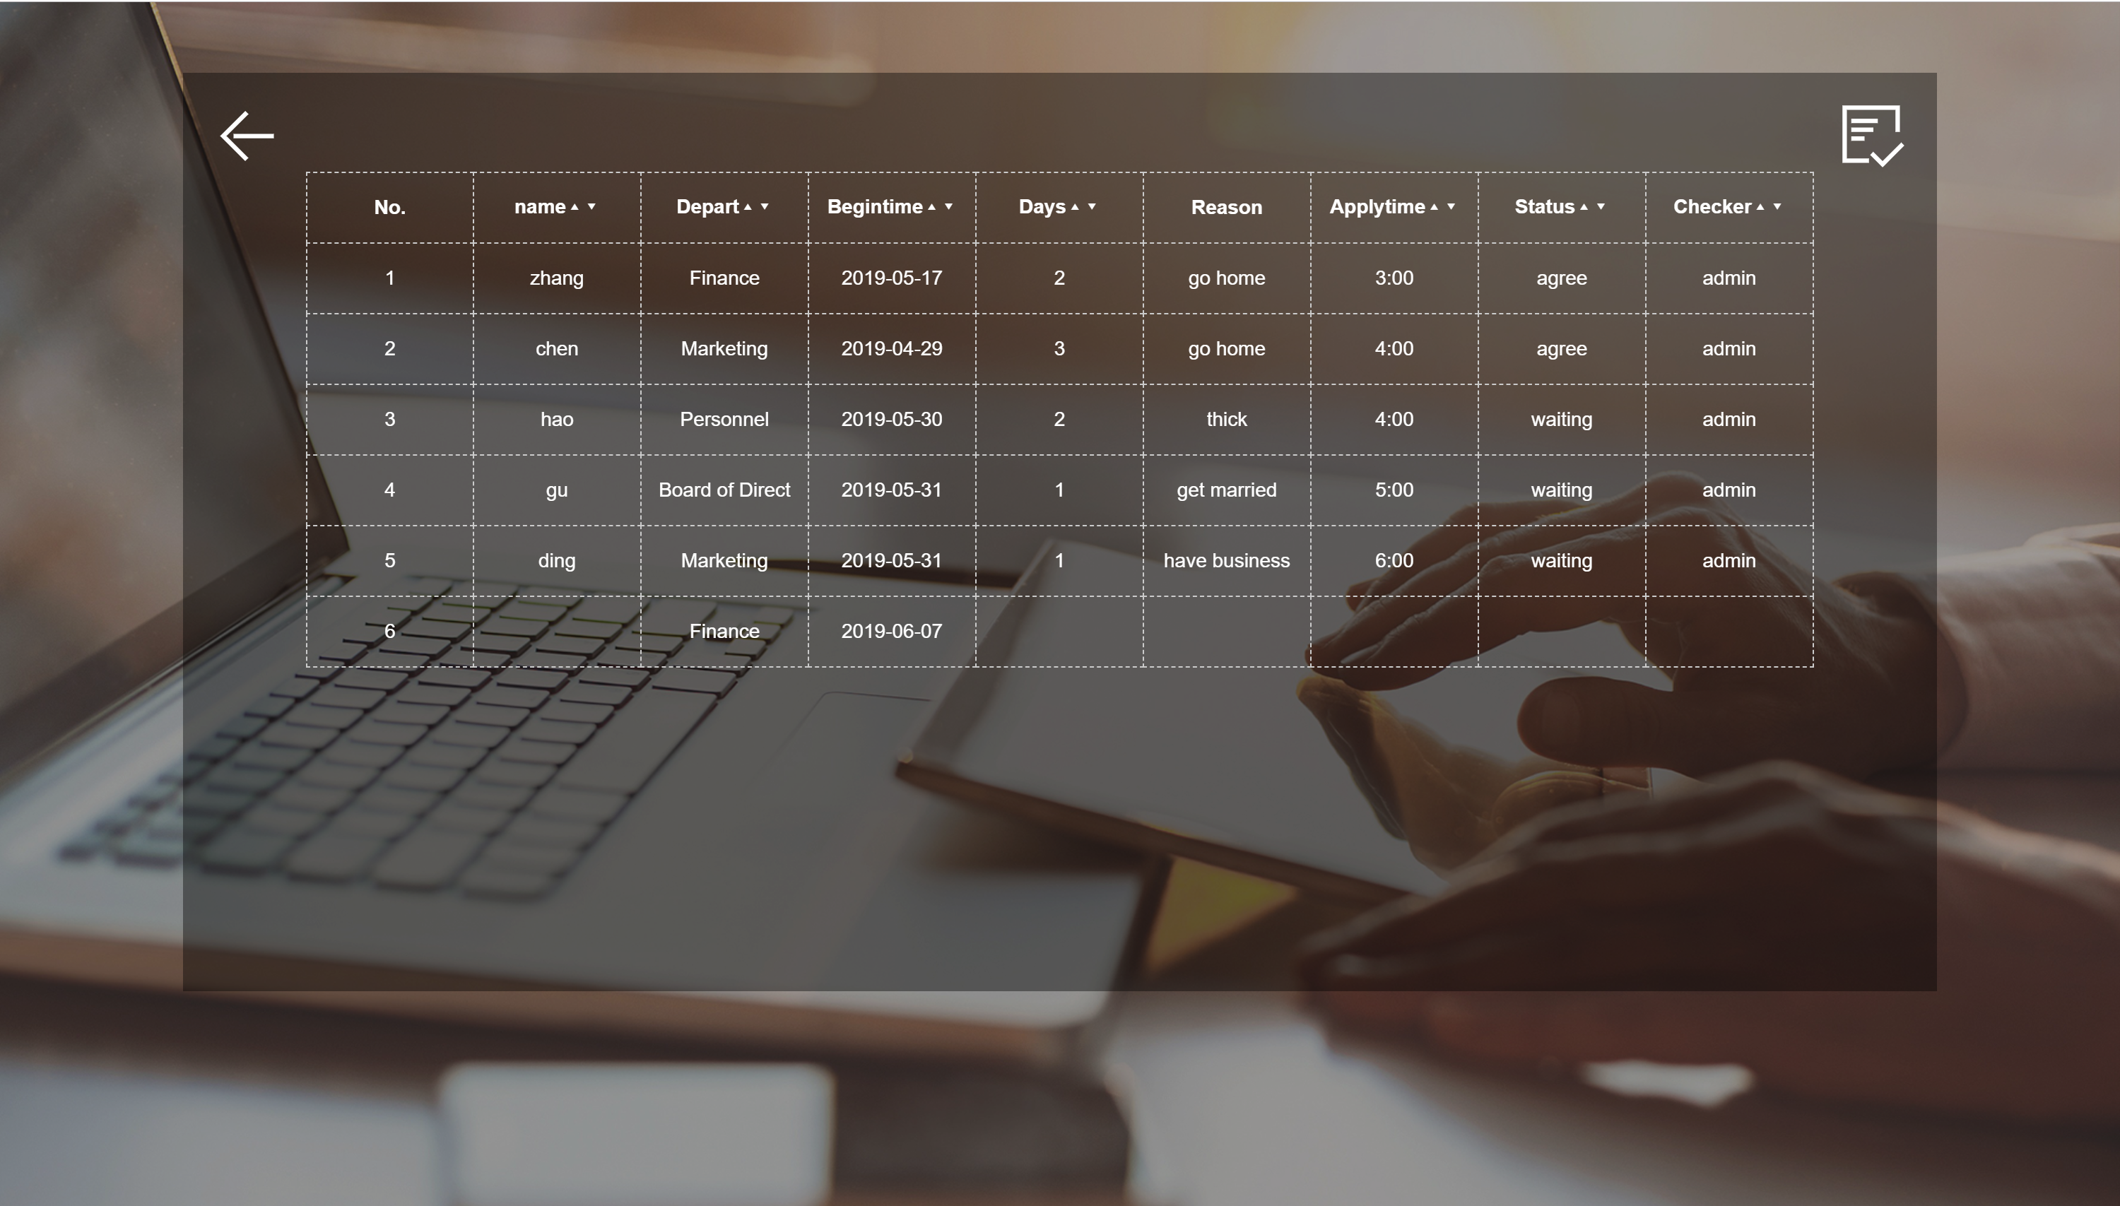
Application List Page:
Order by ASCII

Slide 37
Order Application List Page:
Link to decide application

Slide 38
2019
Thank you for your support during the semester.

Slide 39


